Slide 1
CS301 Project – Group 19 Maximal Independent Set
Group Members:
Emre Koçer 26709
Ege Erdoğan 25331
Hüseyin Kaya 26460
Jankat Yaşar 26635

Slide 2
Table of Contents
1. Problem Description
2. Algorithm Description
3. Algorithm Analysis
4. Sample Generation / An Initial Testing of Implementation of the Algorithm
5. Experimental Analysis of the Performance (Performance Testing)
6. Experimental Analysis of the Correctness (Correctness Testing)
7. References

Slide 3
1.Problem Description
Intuitively, the Independent set corresponds to where there are vertices which are not neighbors of each other in the graph. In addition to this, the Maximal Independent set is the largest possible independent set for the given graph.
Formally for a graph called G(V,E), the maximal independent set is the largest cardinality subset W of V such that no pair of nodes in W is joined by an edge in E.

Slide 4
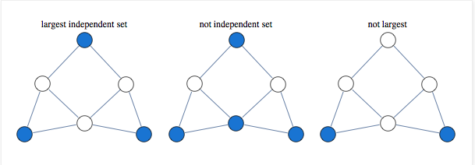
MIS Example
(Figure 1. Taken from: http://yaroslavvb.blogspot.com/2011/03/linear-programming-for-maximum.html)

Slide 5
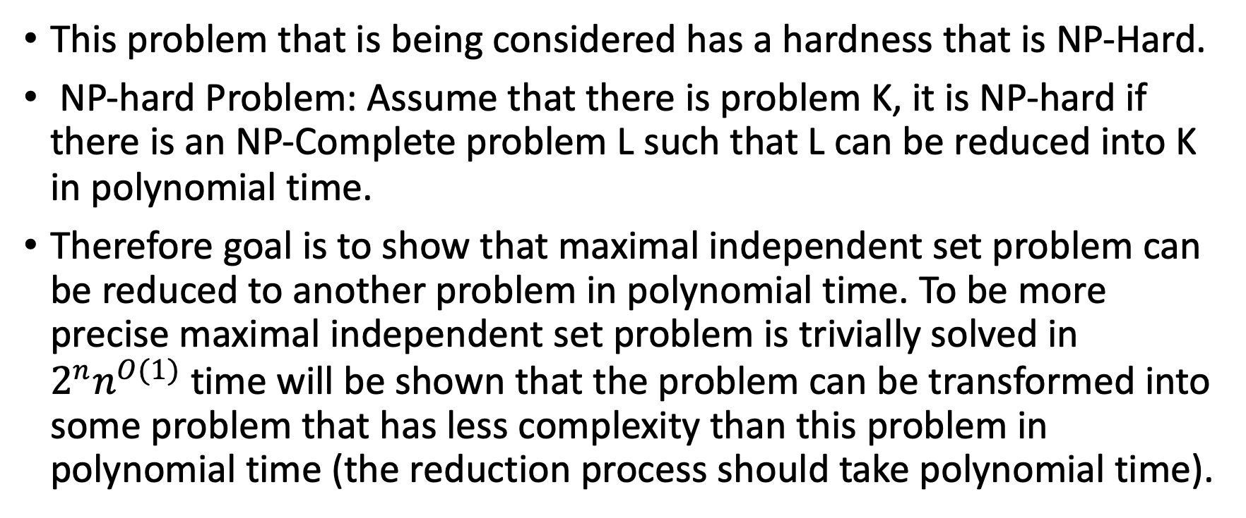
Hardness of The Problem
This problem that is being considered has a hardness that is NP-Hard.
NP-hard Problem: Assume that there is problem K, it is NP-hard if there is an NP-Complete problem L such that L can be reduced into K in polynomial time.
Therefore goal is to show that maximal independent set problem can be reduced to another problem in polynomial time. To be more precise maximal independent set problem is trivially solved in $2^{n}n^{O(1)}$time will be shown that the problem can be transformed into some problem that has less complexity than this problem in polynomial time (the reduction process should take polynomial time).

Slide 6
Show that problem is NP-Complete:
Assume that there is an undirected simple graph denoted as G=(V,E) , let a subset of I⊆ V in G such that now two vertices are connected together.
Now we must check that there isn’t any edge in G that connects at least another vertex in I then we reject it otherwise accept meaning that algorithm runs in polynomial time, so this problem is NP.[2]

Slide 7
Show that problem is NP-Hard:
It is sufficient to show that the NP-Complete problem which is the boolean satisfiability problem which asks for a given problem in boolean algebra what is the fastest algorithm that is denoted as 3SAT can be reducible to independent set problem in polynomial time.
Let F be the boolean function in 3-CNF form, This function f with an input of the boolean formula F shall output a graph, G, and an integer k, That is, we are looking for a f(F) = (G, k) with such that F is satisfiable if and only if G has an independent size of k.[2]

Slide 8
Correctness of F
(⇒): If F is satisfiable, then each of the k clauses of F must have at least one true literal.
Select such a literal from each clause. Let V 0 denote the corresponding vertices from each of the clause clusters (one from each cluster).
We claim that V 0 is an independent set of size k. Since there are k clauses, clearly |V 0 | = k. We only take one vertex from each clause cluster, and we cannot take two conflicting literals to be in V 0 .
For each edge of G, both of its endpoints cannot be in V 0 . Therefore V 0 is an independent set of size k. [3]

Slide 9
Correctness of F (cont’d)
(⇐): Suppose that G has an independent set V 0 of size k.
We cannot select two vertices from a clause cluster, and since there are k clusters, V 0 has exactly one vertex from each clause cluster.
Note that if a vertex labeled x is in V 0 then the adjacent vertex x cannot also be in V 0 .
Therefore, there exists an assignment in which every literal corresponding to a vertex appearing in V 0 is set to 1.
Such an assignment satisfies one literal in each clause, and therefore the entire formula is satisfied.[3]

Slide 10
2. Algorithm Decription

Slide 11
Brute Force Algorithm
The algorithm is exponential time brute force where each vertex is visited with two different possibilities, vertex can be included in the maximum independent set or not.
Each time, the algorithm picks a vertex from the graph and excludes this vertex from the graph.
Then, the algorithm recursively checks the remaining graph to find the maximum independent set.
Algorithm also includes this selected vertex in the maximum independent set and removes its neighbors from the graph.
Then, it tries to maximum independent set with the remaining graph.
Since all vertices are checked and the algorithm runs recursively.
The time complexity is exponential with 2^{n} which results with an inefficient algorithm in terms of run time.

Slide 12
Pseudocode of Brute Force Algorithm
Step 1: Select a vertex from our graph.
Step 2: Exclude this selected vertex from the maximum independent set by deleting the vertex from the graph and recursively call the function. Obtain set 1.
Step 3: Include this selected vertex in the maximum independent set by deleting the vertex and its neighbors from the graph and recursively call the function. At the end, add the selected graph to the result. Obtain set 2.
Step 4: Check which set is larger set 1 or set 2.
Step 5: Return the larger set which is the maximum independent set.

Slide 13
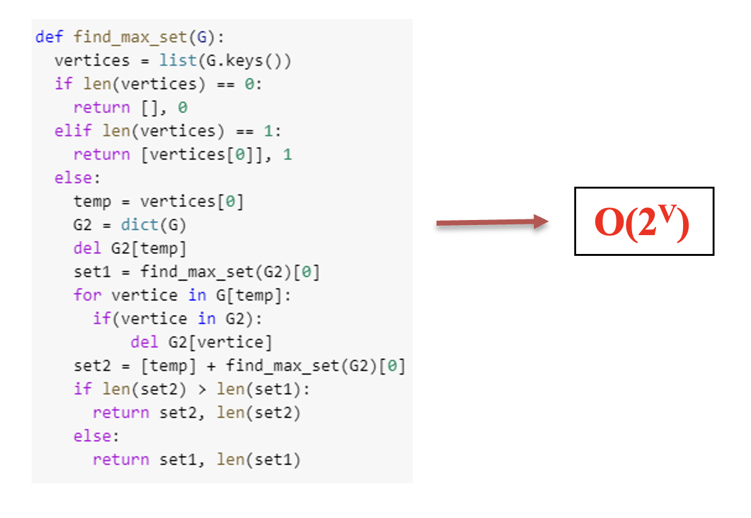
Implementation of Brute Force [5]

Slide 14
Heuristic Algorithm
The algorithm is a greedy algorithm where we need to find the vertex which has the smallest number of edges connected to it in polynomial time.
Every vertex has three characteristics which are "Node id", "Connected vertices ([] as default)" and "Independency (0 as default)".
For every iteration, we mark the node we are working as "Independent (1)" if the "Independency" of a vertex is not set.
Then, we mark as "Not Independent (-1) "for every neighbor of that vertex and call a recursive algorithm for the neighbors of "Not Independent" marked vertices by beginning with the vertex which has the smallest number of neighbors.

Slide 15
Pseudocode of Approximate Algorithm
Step 1: Sorting the neighbours of vertices with respect to their number of neighbours.
Step 2: Creating an empty array called max_independent
Step 3: Choose the vertex with the minimum number of neighbours and call it "min_id"
Step 4: If any of the neighbours of "min_id" did not get marked as independent, the chosen vertex is marked as independent, else marked as not independent.
Step 5: If the chosen vertex was marked as "Independent" its neighbours get marked as "Not Independent".
Step 6: Chosen vertex’s neighbour’s neighbours are evaluated and the one with the minimum number of neighbours gets chosen.
Step 7: The new chosen vertex gets recursively called in the function.
​​Step 8: Find the Independent nodes in the graph.

Slide 16
Detailed Implemented Algorithms

Slide 17
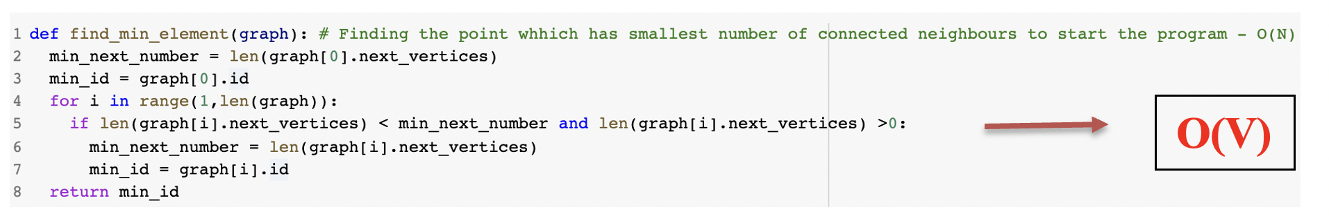
Find_min_element Algorithm

Slide 18
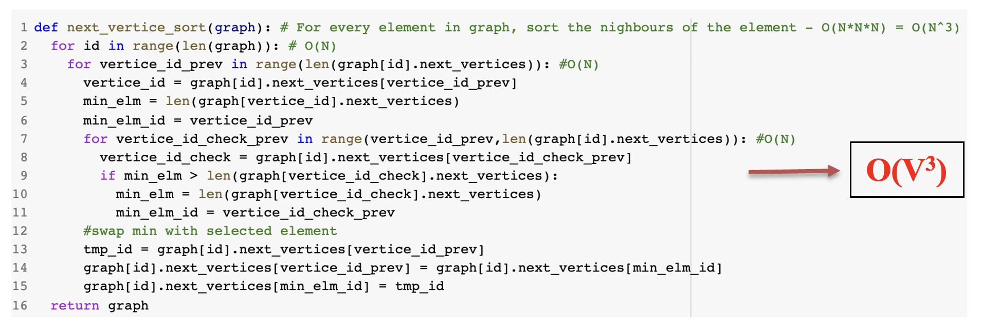
Next_vertice_sort Algorithm

Slide 19
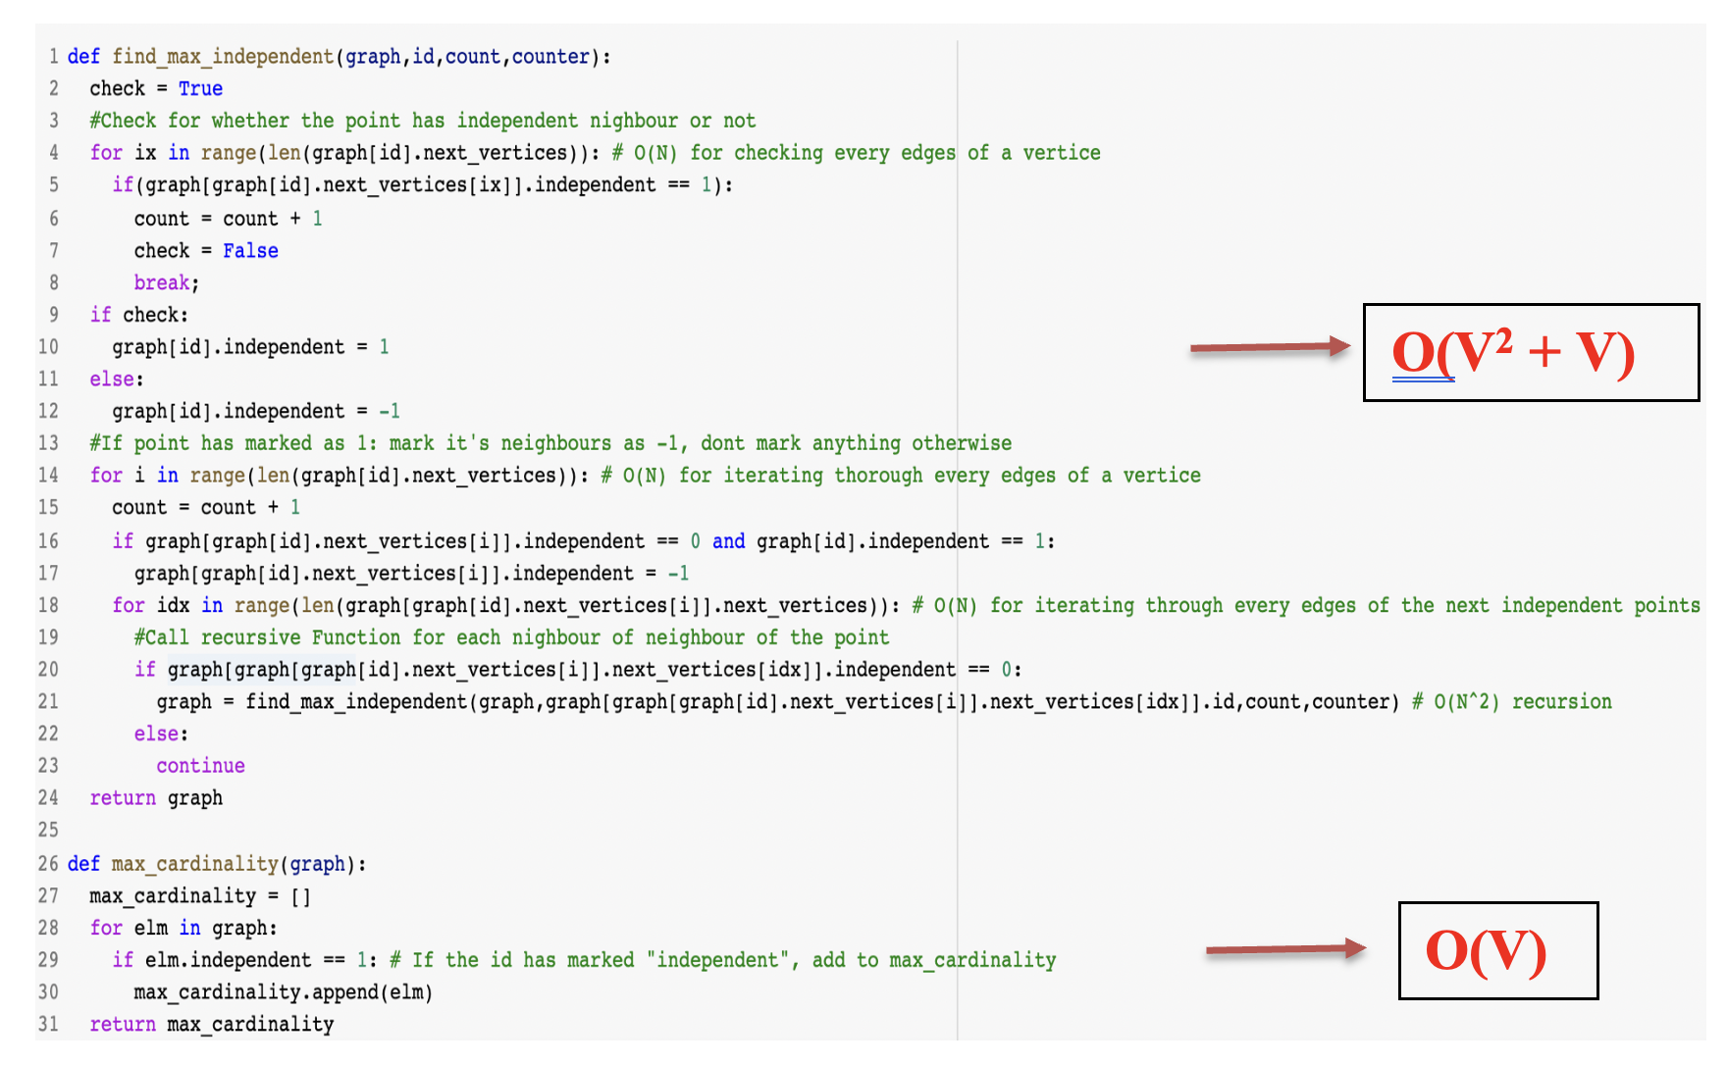
Find_max_independent and max_cardinality Algorithms

Slide 20
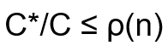
Ratio Bound
Our algorithm can be seen as an example of maximization problem where the size of independent set is trying to be maximized with the below ratio bound formula:
Where C* corresponds to optimal solution and C corresponds to our algorithm’s solution, and ρ(n) corresponds to ratio bound with input size n.
Let’s prove the ratio bound for our approximation algorithm with the help of Gainanov[4]:
Important Proposition: There exists a maximal independent set S ⊆ V such that a vertex v
|S| ≥ max S(G) – m (1)

Slide 21
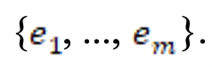
Important Preposition Gainanov[4]
Proof of the proposition: Suppose there are ‘m’ number of missed edges for vertex v denotes as {
, ...,
}.
Important Proposition: There exists a maximal independent set S ⊆ V such that a vertex v
|S| ≥ max S(G) – m (1)
Proof of the proposition: Suppose there are ‘m’ number of missed edges for vertex v denotes as
Add these missing edges to the graph G which denoted as G’ and it is obtained k-vertex which means G has more than k vertices and if we remove a smaller number of k vertices it still stays connected.
From Gainanov’s first proposition, we know that there exists S’ ∈ S_{max}(G’) such that v ∈ S’.
Then, the Corollary 2 of the Gainanov can be used to obtain |S| = max S(G’) ≥ max S(G) – m.
At the end, if the second proposition of Gainanov’s applied to this formula following result can be found to prove (1):
|S| ≥ |S’| ≥ max S(G) – m

Slide 22
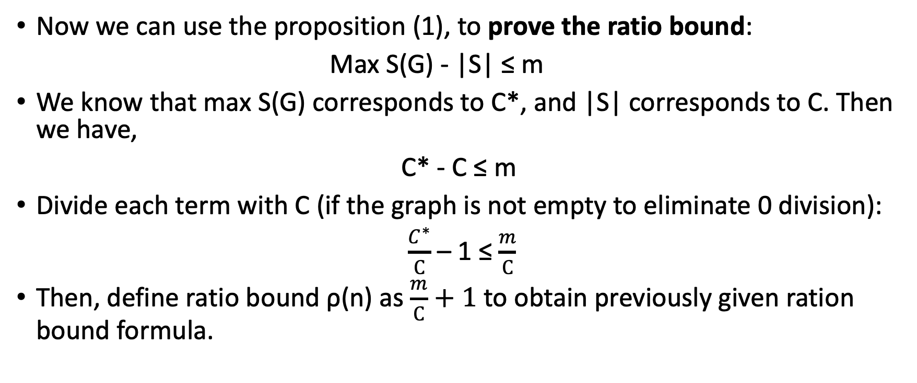
Important Preposition Gainanov[4] cont’d
Now we can use the proposition (1), to prove the ratio bound:
Max S(G) - |S| ≤ m
We know that max S(G) corresponds to C*, and |S| corresponds to C. Then we have,
C* - C ≤ m
Divide each term with C (if the graph is not empty to eliminate 0 division):
$\frac{C^{∗}}{C}$ – 1 ≤ $\frac{m}{C}$
Then, define ratio bound ρ(n) as $\frac{m}{C}+1$ to obtain previously given ration bound formula.

Slide 23
3.Algorithm Analysis

Slide 24
Analysis of Brute Froce Algorithm
The algorithm checks both possibilities for each vertex in the graph. There are only two possibilities: A vertex will be in the maximum independent set or not.
Since both possibilities are checked recursively for each vertex, there are no other additional options to check.
In short, the algorithm exhaustively finds the maximum independent set by considering all cases. Therefore, the algorithm is correct.
The running time of the algorithm can be seen as below recurrence:
T(n) = 2T(n-1) + O(n) = O(2^{n})
The space complexity is 2O(n) where two graphs are used by the algorithm which is simply equal to O(n).

Slide 25
Analysis of Approximate Algorithm
‘Find_min_element’ runs in O(V) as we are visiting each vertex in the graph.
‘Find_max_independent’ function runs in O(V^2 + V) time recursively. However, the ‘next_vertice_sort’ function runs in O(V^3) time, so it dominates for a big number of inputs.
At the last step, we find the independent nodes by ‘Max_Cardinality’ and it operates in O(V) time. Therefore, we can say that our time complexity is O(V^3) as it is dominating one.
Space Complexity is O(V^2) as we have only Vertices and Edges in our memory.

Slide 26
Correctness of Approximation Algorithm:
The proposed algorithm always finds an independent set. However, this resulted independent set may not be the maximum independent set, i.e., optimal solution as the algorithm is heuristic.
There are two possible scenarios for each vertex in the graph:
1) A vertex may be in the maximum Independent set:
2) A vertex may not be in the maximum independent set:

Slide 27
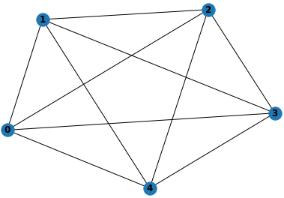
1) A vertex may be in the maximum Independent set:
Suppose selected vertex is the vertex 0 and its independency will be equal to 1, i.e, it is chosen as independent vertex and in the maximum independent set.
Since the algorithm assigning neighbors of this selected vertex independency as -1, i.e., neighbors are chosen as dependent vertices, and they are not in the maximum independent set.
Therefore, there is no possibility to have two connected vertices in the resulted set of the algorithm.

Slide 28
2) A vertex may not be in the maximum independent set:
Suppose selected vertex is the vertex 0 and its independency is equal to -1 because of one of its neighbors, i.e, it is chosen as dependent vertex, and it is not in the maximum independent set.
Then, it is obvious that one of its neighbors is in the maximum independent set as the vertex 0 has independency equal to -1.
Therefore, there is no possibility to have two connected vertices in the resulted set of the algorithm.
In result, there is no possible collision in the result of the proposed approximation algorithm as it does not care about nodes which have independency equal to -1.

Slide 29
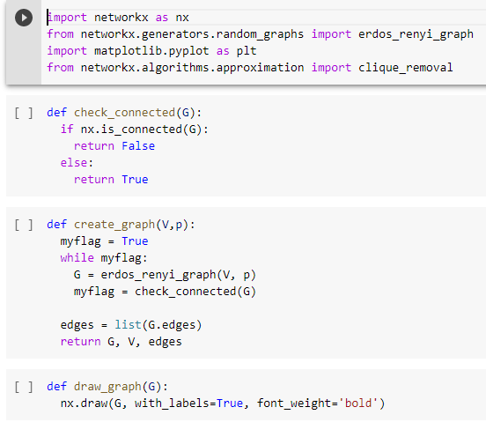
4. Sample Generation / An Initial Testing of Implementation of the Algorithm
Samples are generated by utilizing the networkx library of Python. Graphs are checked whether they are connected or not before testing as the maximum independent set is considered while having a connected graph.
Implementation:

Slide 30
Test Graphs and Results with Exact Brute Force Algorithm:

Slide 31
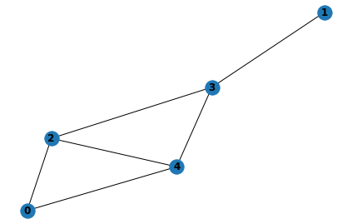
First Test with 5 vertices

Slide 32
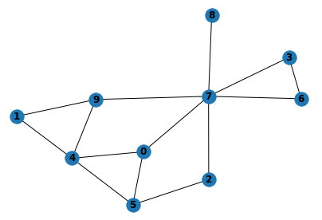
Second Test with 10 vertices

Slide 33
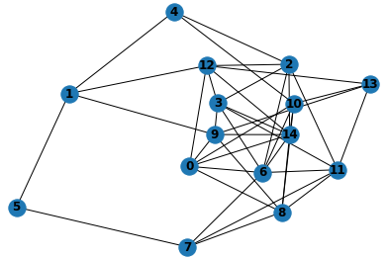
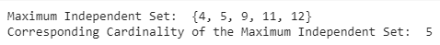
Second Test with 10 vertices

Slide 34
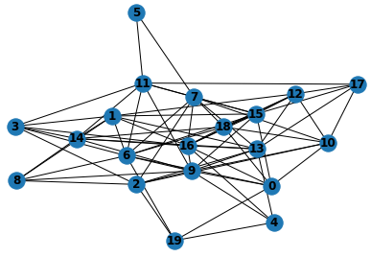
Last Test with 20 vertices

Slide 35
Test Graphs and Results with Approximate Algorithm:

Slide 36
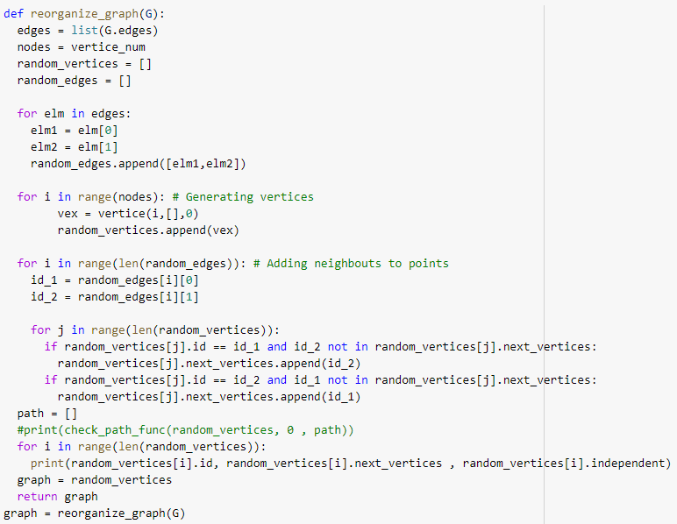
Random Graph Generation Algorithm
Notation for below examples:
First column: Vertex id
Second column: Neighbors
Third Column: Independency (It is 1 if the corresponding Vertex is in the independent set)

Slide 37
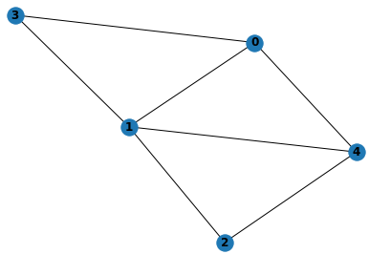
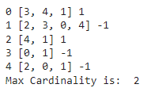
First Test with 5 Vertices:

Slide 38
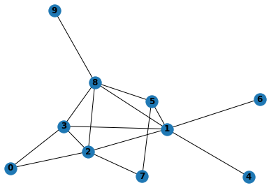
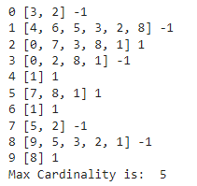
Second Test with 10 Vertices:

Slide 39
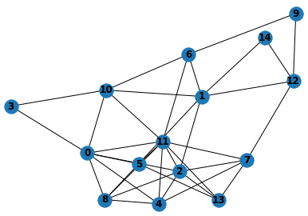
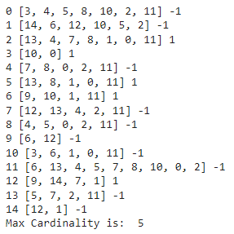
Last Test With 15 Vertices:

Slide 40
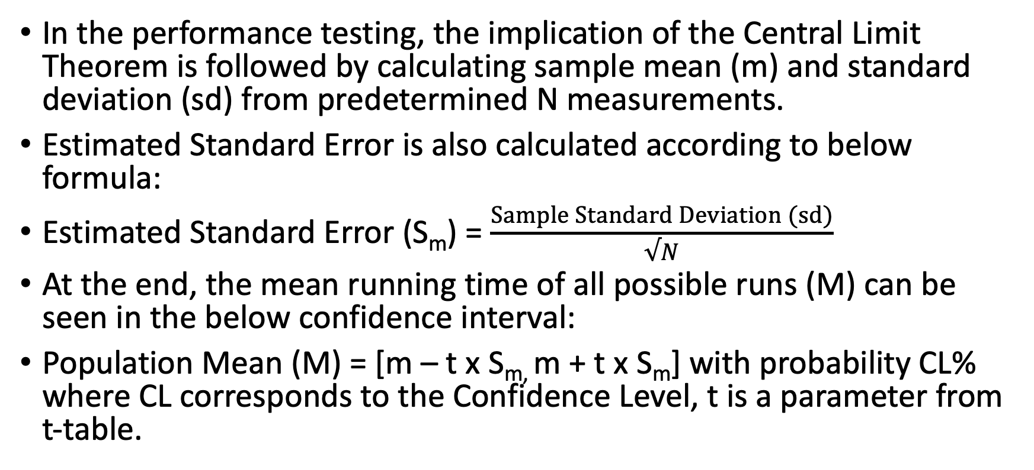
5. Experimental Analysis of the Performance (Performance Testing)
In the performance testing, the implication of the Central Limit Theorem is followed by calculating sample mean (m) and standard deviation (sd) from predetermined N measurements.
Estimated Standard Error is also calculated according to below formula:
Estimated Standard Error (S_{m}) = $\frac{Sample Standard Deviation (sd)}{√N}$
At the end, the mean running time of all possible runs (M) can be seen in the below confidence interval:
Population Mean (M) = [m – t x S_{m,} m + t x S_{m}] with probability CL% where CL corresponds to the Confidence Level, t is a parameter from t-table.

Slide 41
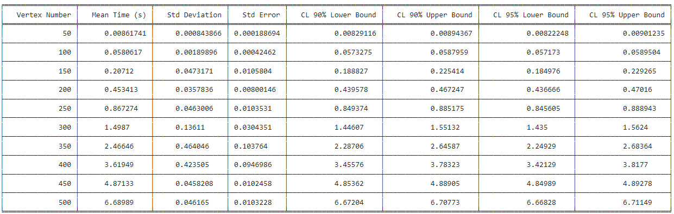
Mean Running Times – Vertice Number
Firstly, relation between mean running time and the number of vertices is investigated with 90% and 95% Confidence Level, and N = 20 runs of our program for a certain number of vertices while having constant Edge Density with the parameter p = 0.4. Corresponding t values for both confidence levels are 1.729 and 2.093 respectively.
Results can be seen below table:

Slide 42
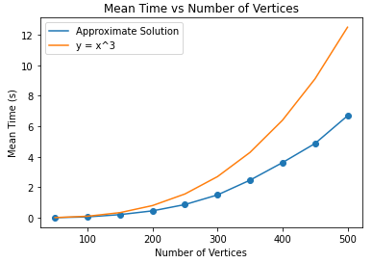
Result Plot
Non-surprisingly, mean running time of the algorithm increases as the number of vertices are increasing. It can be seen that our time complexity follows O(V³) as proposed.

Slide 43
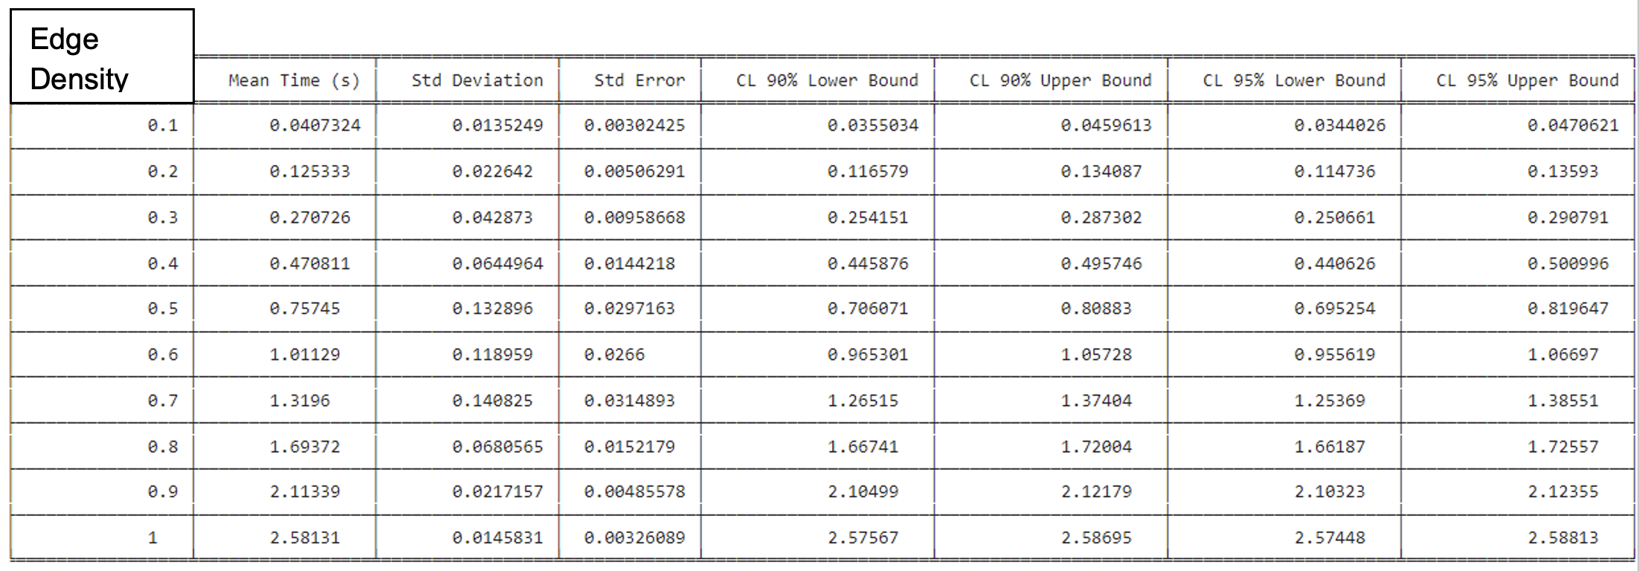
Mean Running Time and the Edge Density
Secondly, relation between mean running time and the Edge Density is investigated with 90% and 95% Confidence Level, and N = 20 runs of our program for a certain number of vertices while having constant number of vertices as 200. Corresponding t values for both confidence levels are 1.729 and 2.093 respectively.
Results can be seen below table

Slide 44
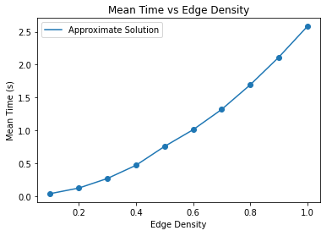
Plot Result
It can be observed that mean running time of the algorithm increases as the Edge Density is increasing. It confirms our proposal that sorting (‘next_vertice_sort’) is the most time-consuming part in our algorithm.

Slide 45
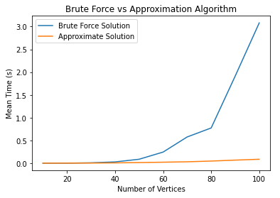
Exact and Approximation Algorithms’ Running Times
It can be seen that brute force solution dominates the approximation solutions as its time complexity is exponential time compared to polynomial time.

Slide 46
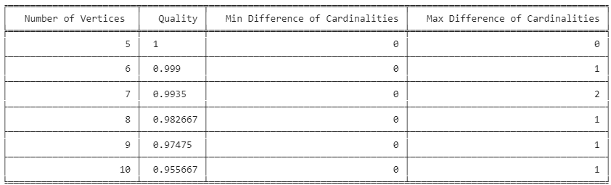
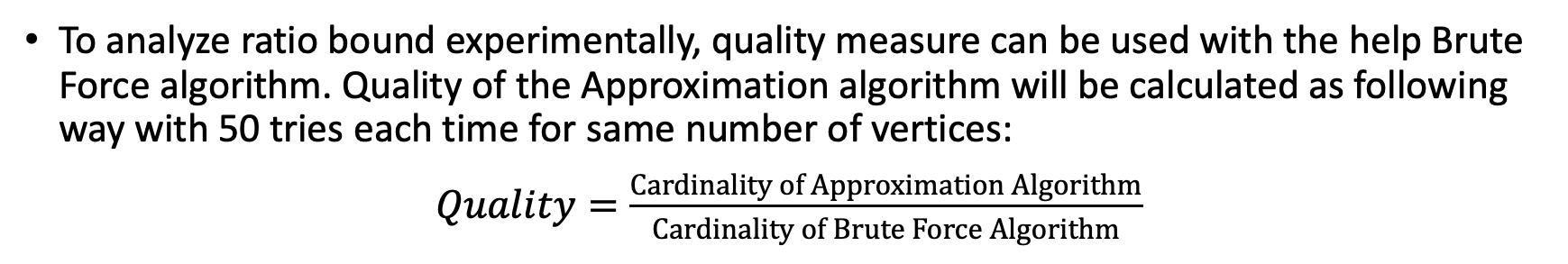
Quality
To analyze ratio bound experimentally, quality measure can be used with the help Brute Force algorithm. Quality of the Approximation algorithm will be calculated as following way with 50 tries each time for same number of vertices:
$Quality=\frac{Cardinality of Approximation Algorithm}{Cardinality of Brute Force Algorithm}$

Slide 47
6. Experimental Analysis of the Correctness (Correctness Testing)
Proposed approximation algorithm may find an independent set which is not a maximum independent set for a given graph.
However, its result is always an independent set which is explained in the algorithm analysis part.
Therefore, we can say that approximation algorithm is correct. To prove this argument, approximation algorithm is executed for 200 times with 100 number of vertices which is quite big graph.
Then, each time result of the algorithm is checked whether it is an independent set or not.

Slide 48
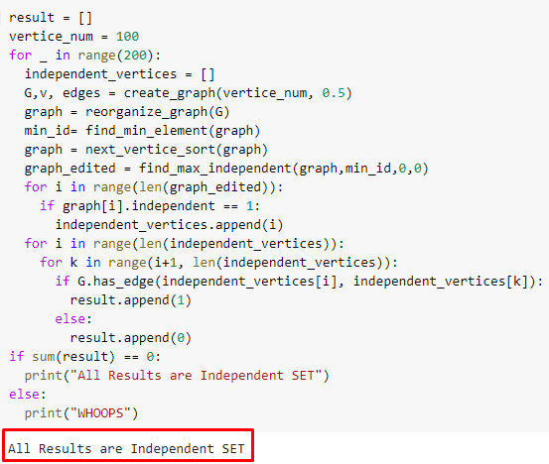
Showing Independency of Result Implementation:
In the implementation, networkx’s hasedge() function is utilized to check if there is an edge between a vertex and the other vertex in the result of approximation algorithm.
Implementation:

Slide 49

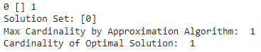
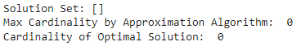
Black Box Testing
We performed Black Box testing to check correctness of our algorithm with the help of Exhaustive Search algorithm.
We tried extreme cases to see whether approximation algorithm is correct or not as following examples:
Test 1: Empty Graph
Test 2: 1 Vertex Only Graph

Slide 50
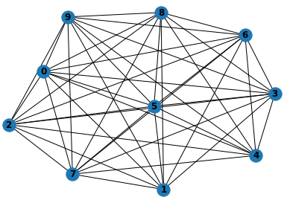
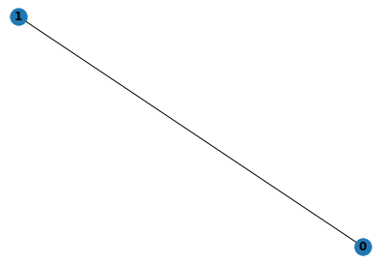
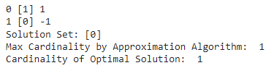
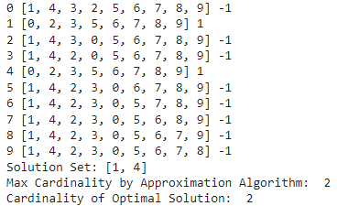
Tests (cont’d)
Test 4: 10 Vertices with high Dense Edges Graph
Test 3: 2 Vertices Graph

Slide 51
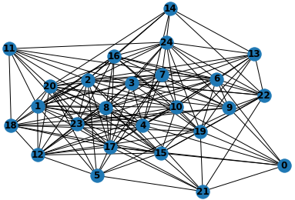
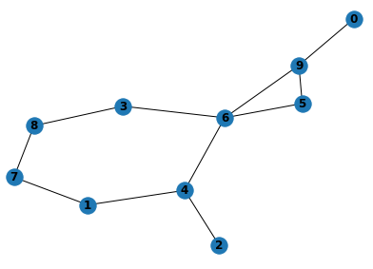
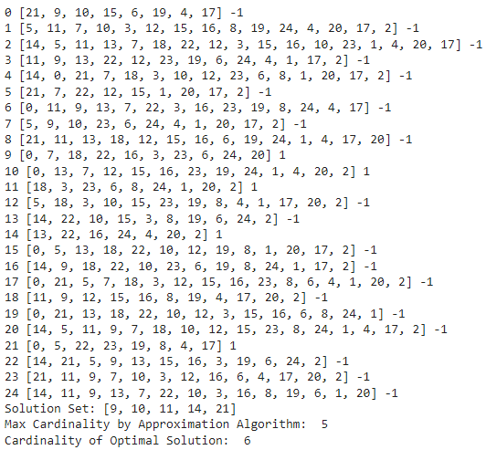
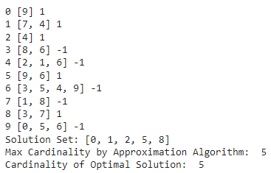
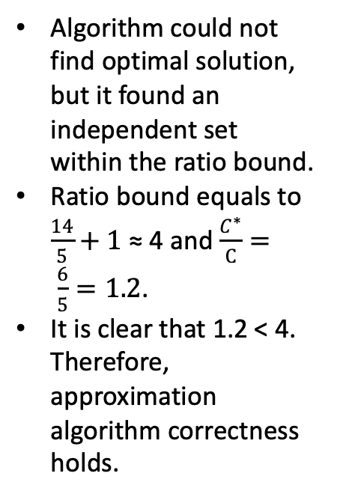
Tests (cont’d)
Test 6: 25 Vertices Graph
Test 5: 10 Vertices with low Dense Edges Graph
Algorithm could not find optimal solution, but it found an independent set within the ratio bound.
Ratio bound equals to $\frac{14}{5}+1$ ≈ 4 and $\frac{C^{∗}}{C}= \frac{6}{5}=1.2$.
It is clear that 1.2 < 4. Therefore, approximation algorithm correctness holds.

Slide 52
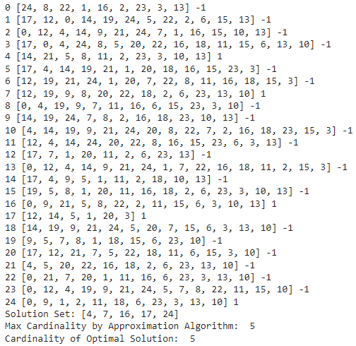
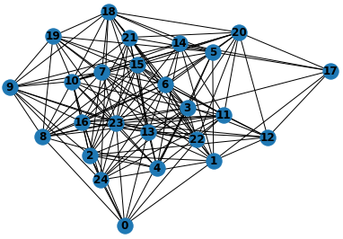
Tests (cont’d)
Test 7: Repeat Test 6 to see it can find an optimal solution for 25 vertices Graph

Slide 53
7.Discussion
The approximation algorithm is designed and implemented for the Maximum Independent Set problem which is an NP-Hard problem in polynomial time O(V³) compared to brute force exponential time O(2^{V}).
Since proposed algorithm is a Heuristic algorithm, it may not find the optimal solution for given graph as there is a trade-off between the runtime and finding optimal solution.
The correctness and ratio bound of the algorithm is shown in the algorithm description and analysis parts.
Sample generation is done by utilizing Networkx library of Python.
Then, the approximation algorithm is analyzed experimentally.
Firstly, it gone through the performance testing to demonstrate its running time for different scenarios (changing vertex number & edge density) and comparison between brute force algorithm by using the implication of Central Limit Theorem.
It is found that algorithm has slightly better upper bound for time complexity than theoretical O(V³). Also, algorithm’s quality for different number of vertices shown in the performance testing part where the quality decreases as the number of vertices increasing in the graph.
Secondly, the algorithm gone through the functionality test to demonstrate its correctness. In the functionality test, proposition of the result of the algorithm’s is an independent set is proved by experimentally.
Then, Black Box testing is used with number of different extreme cases to show algorithm is working correctly.

Slide 54
8. References
[1]Eddy, D., & Kochenderfer, M. J. (2021). A Maximum Independent Set Method for Scheduling Earth-Observing Satellite Constellations. Journal of Spacecraft and Rockets, 1-14.
[2]Yan, Chengxiao & Berube, Rachel & Damodara, Srikant. (2020). The Independent Set and NP- Completeness.
[3]http://www.cs.umd.edu/class/fall2017/cmsc451-0101/Lects/lect20-np-3sat.pdf
[4]Gainanov, D. N., Mladenovic, N., Rasskazova, V., & Urosevic, D. (2018, January). Heuristic algorithm for finding the maximum independent set with absolute estimate of the accuracy. In Proc. CEUR Workshop (pp. 141-149).
[5] https://www.geeksforgeeks.org/maximal-independent-set-in-an-undirected-graph/

